Slide 1

Where is a mobile map used in map-assisted pedestrian navigation?
Author: Zhengfang Xu
Supervisor: Prof. Dr. Sara Irina Fabrikant
Dr. Mona Bartling

Slide 2
Intro
RQ
Data
Method
Timeline
When exploring a new city and navigating to a new place, Where do you check the map?

Slide 3
Intro
RQ
Data
Method
Timeline
Related research: Aim to check the map
Wayfinding behavioral actions are those linked to
orientation,
route decision,
route monitoring,
destination recognition
(Carpman& Grant, 2002)

Slide 4
Intro
RQ
Data
Method
Timeline
Related research: Checking the map & Decision making
Pedestrians tend to make decisions before reaching intersections.
People with higher spatial ability, earlier to make decisions.
(Brunyé, T. T. et al., 2018)

Slide 5



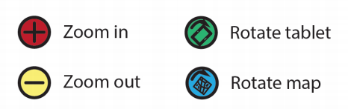
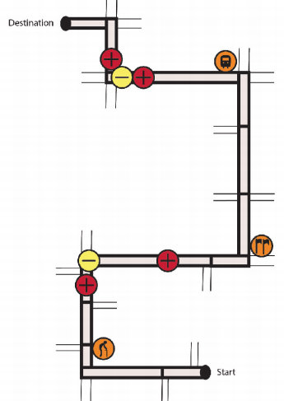
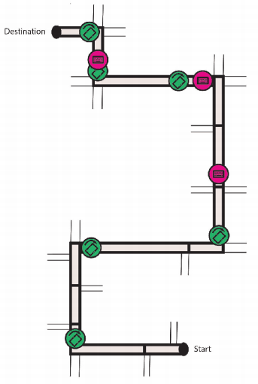
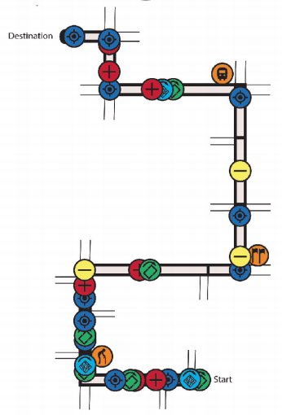
Intro
RQ
Data
Method
Timeline
Related research: Types of Map Use Strategies
constant
support
independent and attentive
least effort and inattentive
(Webber. et al., 2012)
(Annina. et al., 2020) Taking specific map interaction types into consideration.

Slide 6
Intro
RQ
Data
Method
Timeline
Research Gap:
Limited route variability:
when pedestrians' routes change (e.g., in terms of length, number of turns, whether shortcuts are used, etc.), how do patterns of map checking change?
Less consideration of context influences:
How do environmental changes such as traffic density affect people's patterns of map-checking?

Slide 7
Intro
RQ
Data
Method
Timeline
Research Question:
What are the trajectory factors that influence when and where pedestrians check the mobile map during walking navigation?
What are the differences in map-checking behavior between high and low traffic density environments?

Slide 8

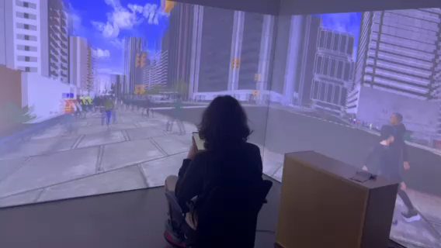
Intro
RQ
Data
Method
Timeline
Data Resource: VR Experiment in CAVE (09.2023 – 10.2023)
Type: Mobile map assisted wayfinding task
Total participants: 54
Context factor: Traffic density (heavy/low)
Number of tasks: 863

Slide 9

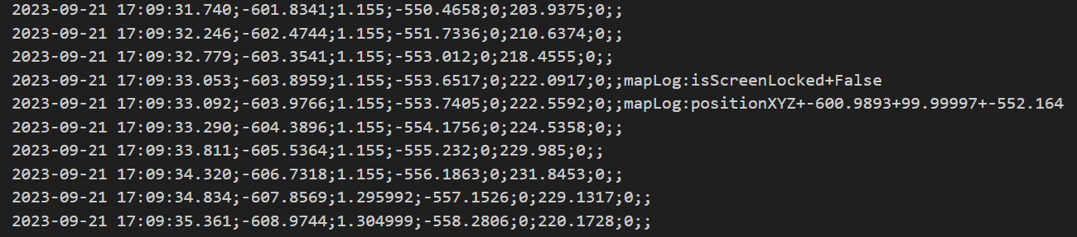
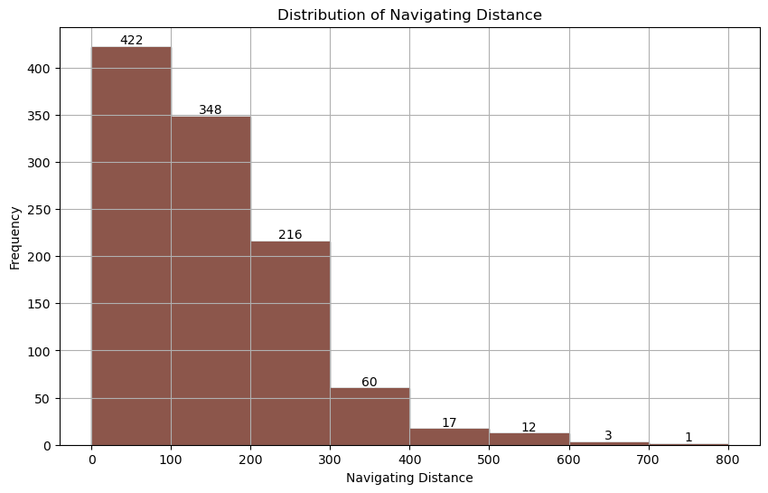
Intro
RQ
Data
Method
Timeline
Data Display: Log File
Data Display: Interactive Visualization

Slide 10

Intro
RQ
Data
Method
Timeline
Method :
Map-Checking Points Determination
Regard points with screenLock_False log as checking points
Trajectory clustering or segmentation
Group similar trajectories based on spatial proximity or other relevant criteria
Comparative Analysis
Compare different trajectory group and traffic density group
Extract relevant trajectory factors
Map-checking Pattern Recognition

Slide 11
Intro
RQ
Data
Method
Timeline
1 Feb. 2024
Start of master thesis
16 Apr. 2024
Concept talk
15 May 2024
Descriptive analysis
15 June 2024
Trajectory Clustering
15 July 2024
Comparative Analysis
31 Aug. 2024
Thesis writing
30 Sep. 2024
Submission of the Master’s Thesis
1 Nov. 2024
Master’s Exam

Slide 12

Thank you very much!

